Slide 1


Is delay always
harmful to precision?
Nikolett Német*, Scott Parkins
University of Auckland,
The Dodd-Walls Centre for Photonic and Quantum Technologies
Physics Seminar 01/06/16
*n.nemet@auckland.ac.nz

Slide 2
Outline
Measurement precision
Classical fluctuations
Standard quantum limit (SQL)
Squeezed state
Phase space
Degenerate Parametric Amplifier
DPA with coherent feedback
DPA with time-delayed coherent feedback
Quantum mechanical model
Squeezing spectra
Classical analysis

Slide 3
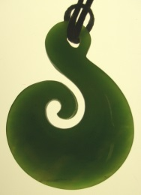
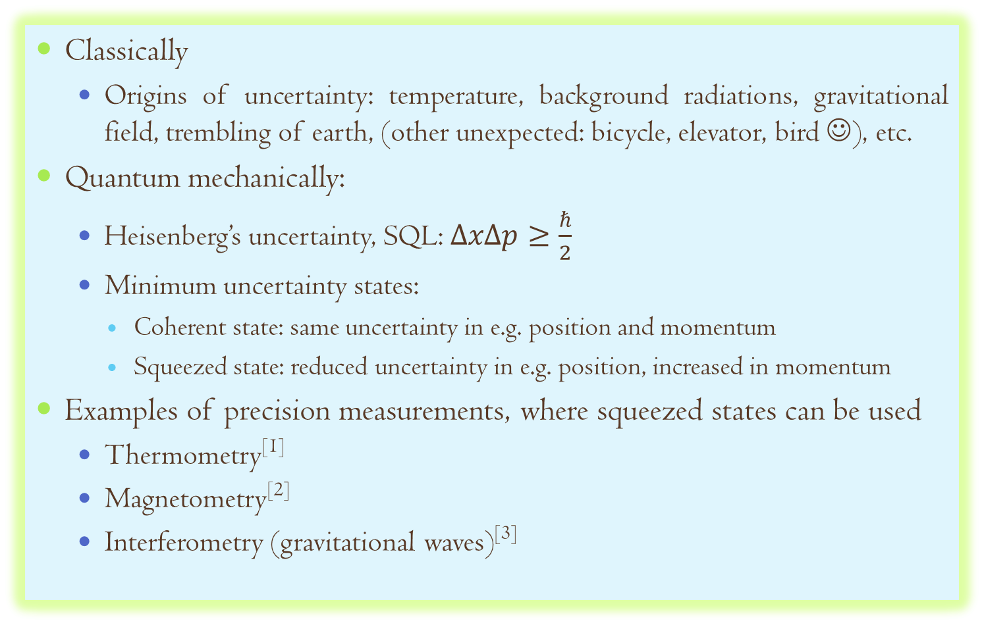
Measurement precision
Classically
Origins of uncertainty: temperature, background radiations, gravitational field, trembling of earth, (other unexpected: bicycle, elevator, bird ☺), etc.
Quantum mechanically:
Heisenberg’s uncertainty, SQL: $ΔxΔp≥\frac{ℏ}{2}$
Minimum uncertainty states:
Coherent state: same uncertainty in e.g. position and momentum
Squeezed state: reduced uncertainty in e.g. position, increased in momentum
Examples of precision measurements, where squeezed states can be used
Thermometry^{[1]}
Magnetometry^{[2]}
Interferometry (gravitational waves)^{[3]}
^{[1]} Q. Wang et al, PRA, 91:063827 (2015), ^{[2]}N. Otterstrom et al, Opt. Lett., 39:6533 (2014), ^{[1]} E. Oelker et al, PRL, 116:041102 (2016),

Slide 4
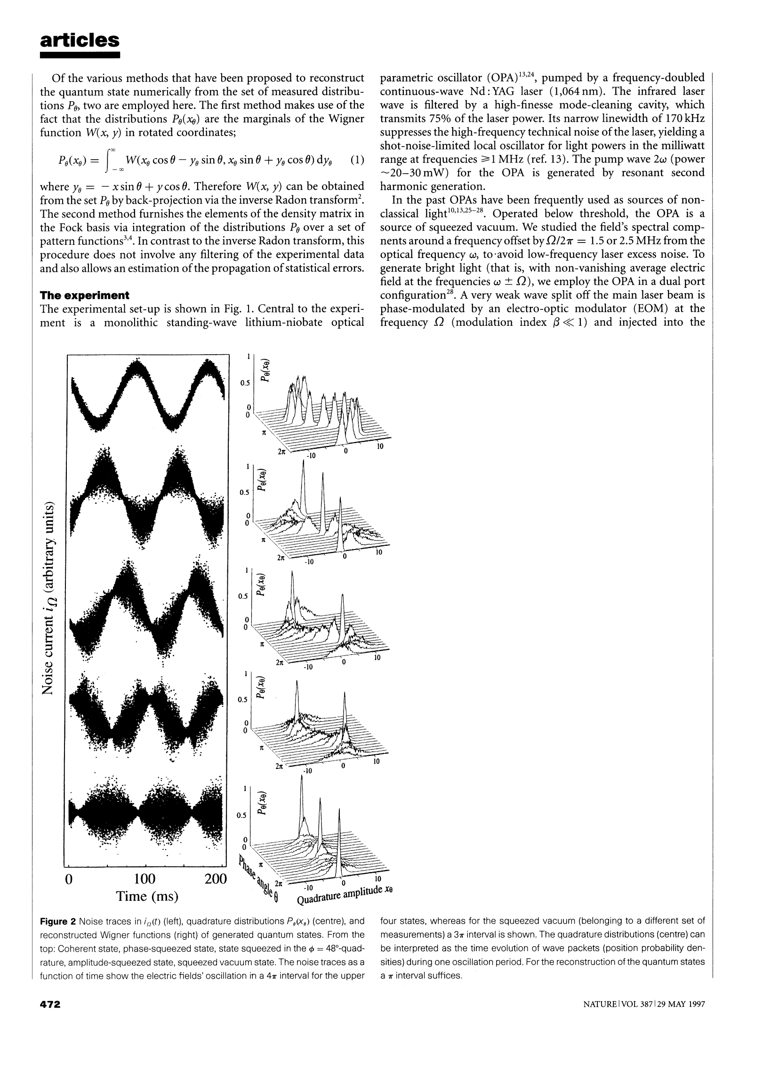
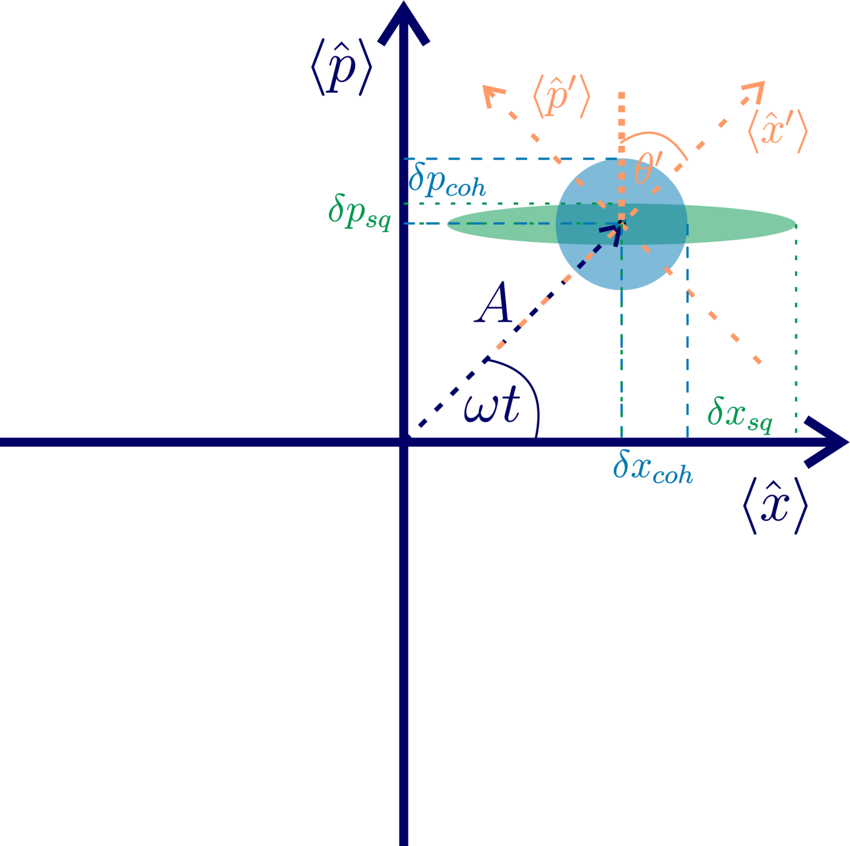
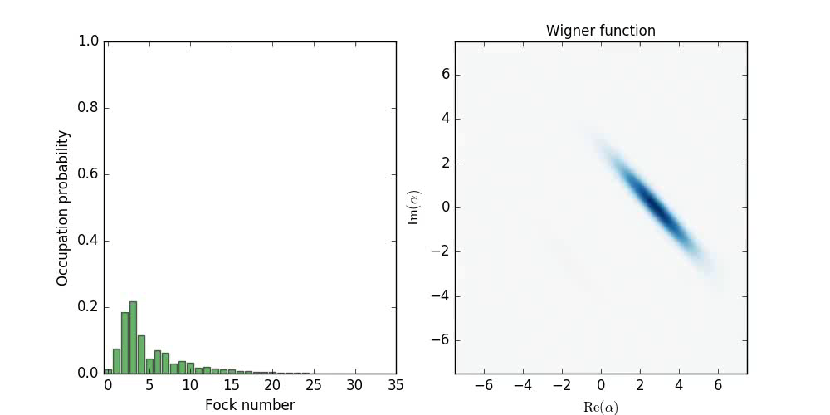
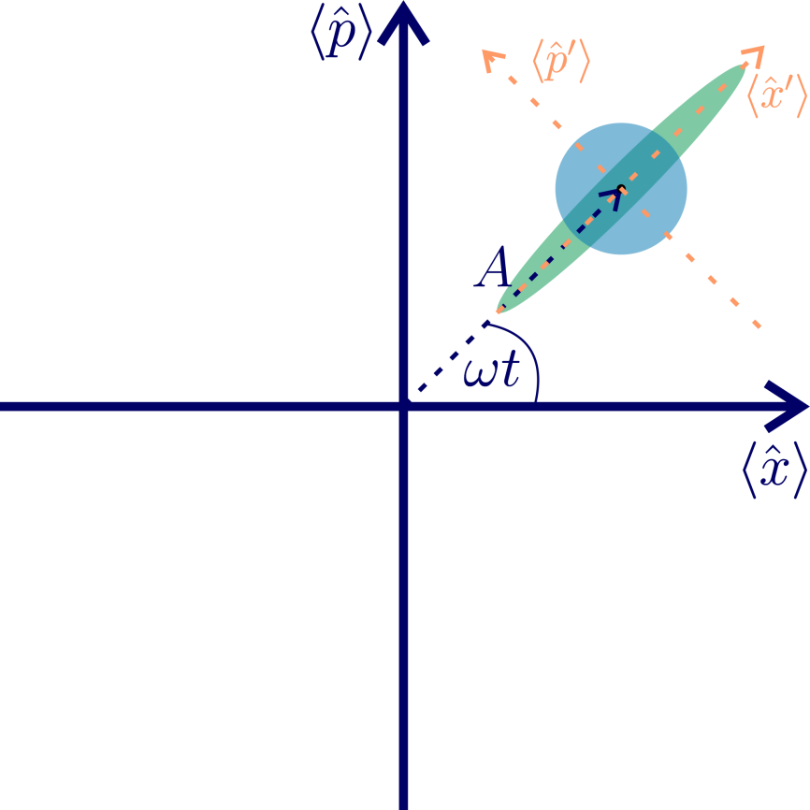
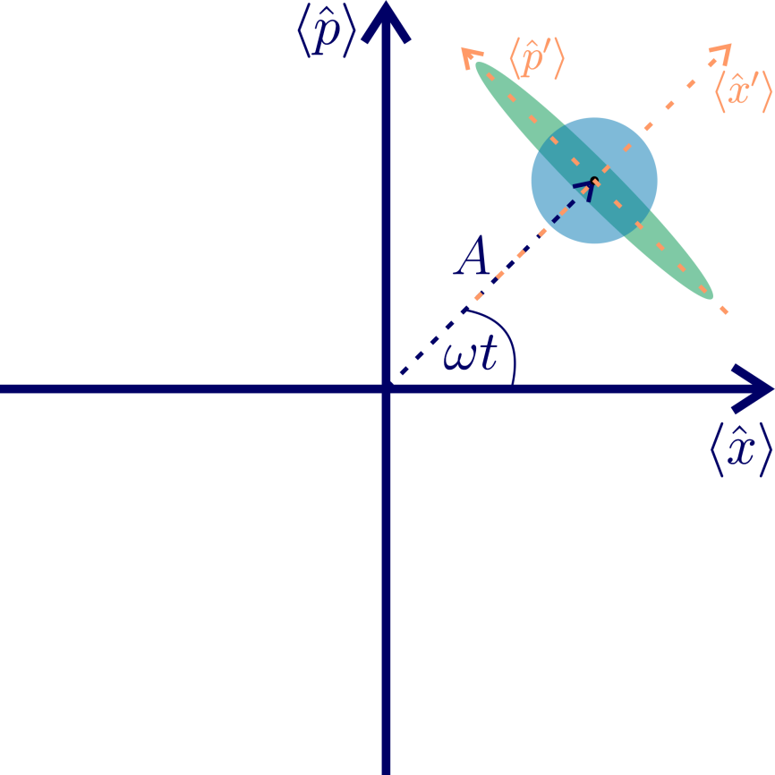
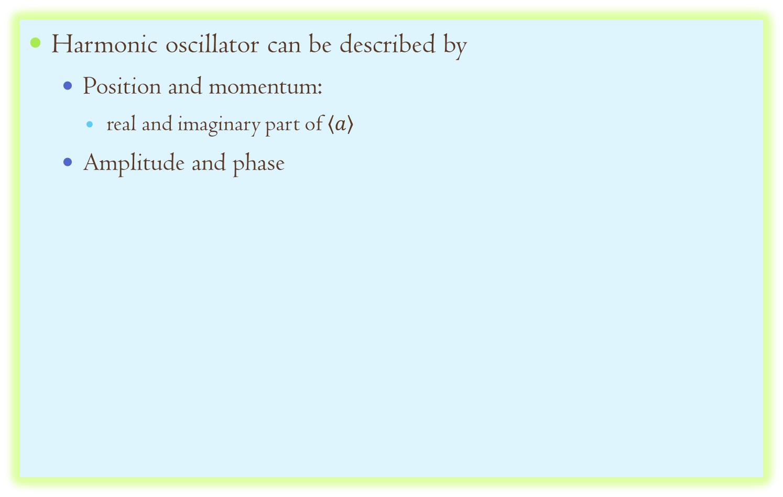
Squeezed State
Harmonic oscillator can be described by
Position and momentum:
real and imaginary part of$\left\langle a\right\rangle$
Amplitude and phase
^{[1]}
Phase squeezed state
Amplitude squeezed state
^{[1]} G. Breitenbach, S. Schiller, J. Mlynek, Nature, 387:471 (1997)

Slide 5
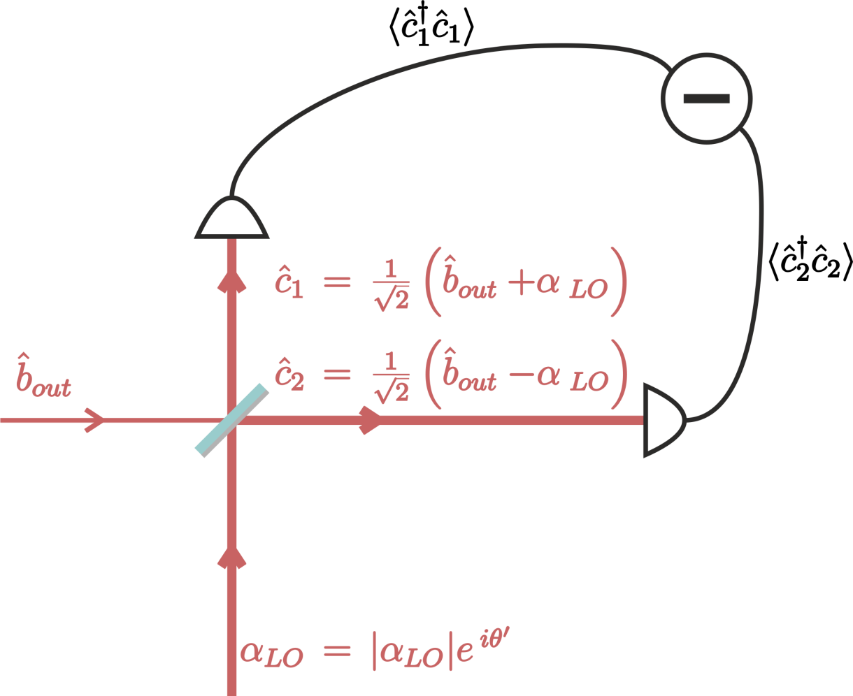
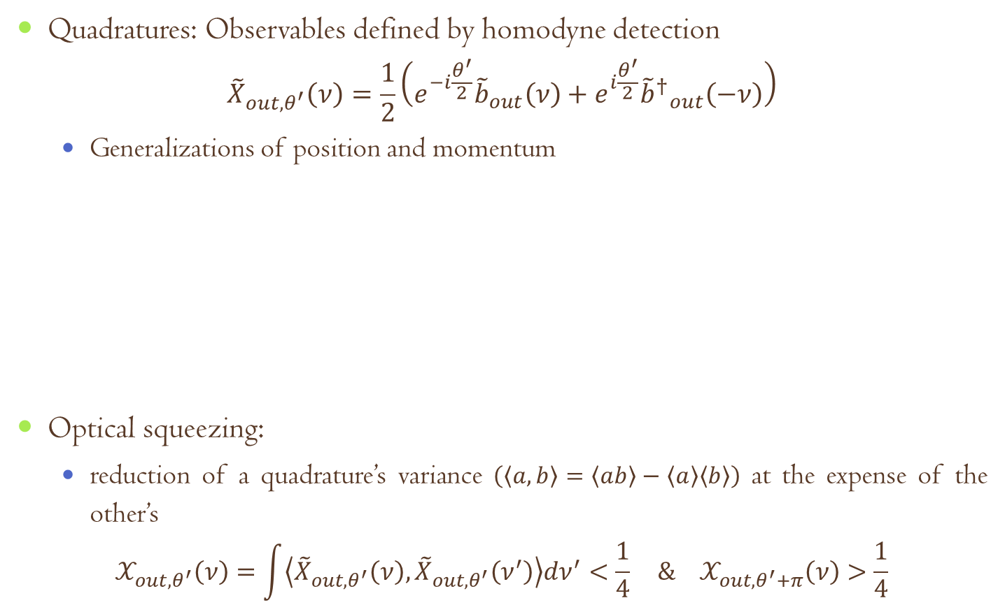
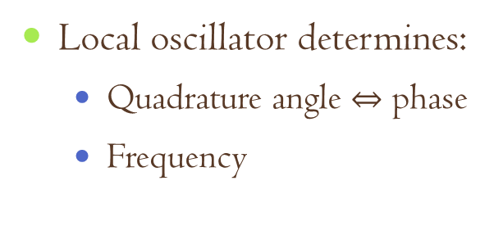
Optical squeezing
Quadratures: Observables defined by homodyne detection
$${\tilde{X}}_{out,θ^{′}}\left(ν\right)=\frac{1}{2}\left(e^{−i\frac{θ^{′}}{2}}{\tilde{b}}_{out}\left(ν\right)+e^{i\frac{θ^{′}}{2}}{{\tilde{b}}^{†}}_{out}^{}\left(−ν\right)\right)$$
Generalizations of position and momentum
Optical squeezing:
reduction of a quadrature’s variance $\left(\left\langle a,b\right\rangle =\left\langle ab\right\rangle −\left\langle a\right\rangle \left\langle b\right\rangle \right)$ at the expense of the other’s
$$𝒳_{out,θ^{′}}\left(ν\right)=\int{\left\langle {\tilde{X}}_{out,θ^{′}}\left(ν\right),{\tilde{X}}_{out,θ^{′}}\left(ν^{′}\right)\right\rangle dν^{′}<\frac{1}{4}} \& 𝒳_{out,θ^{′}+π}\left(ν\right)>\frac{1}{4}$$
Local oscillator determines:
Quadrature angle $⇔$ phase
Frequency

Slide 6
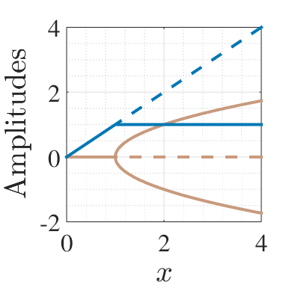
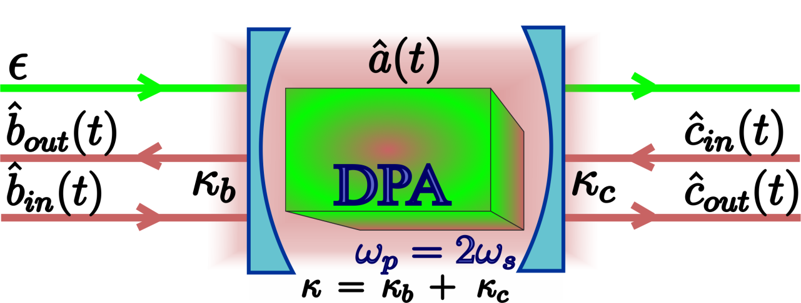
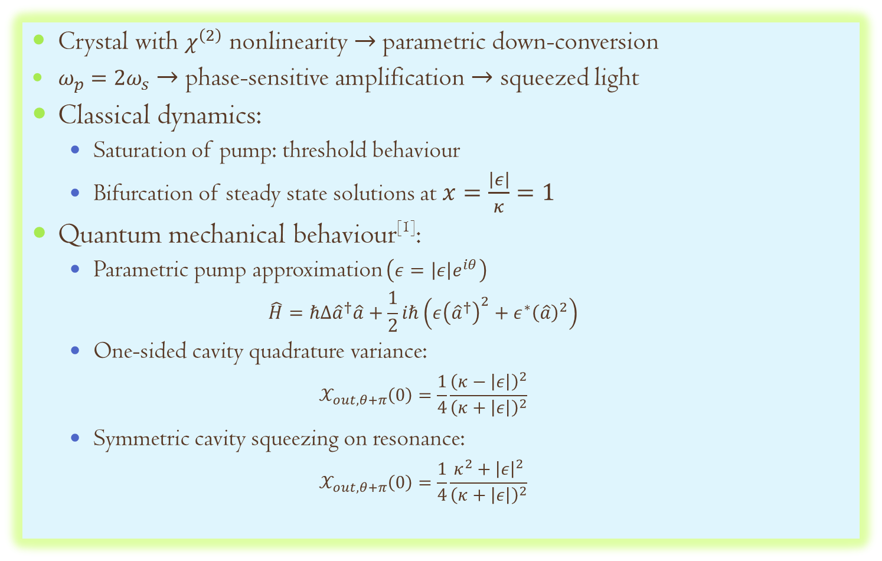
Degenerate Parametric Amplifier
Crystal with $χ^{\left(2\right)}$ nonlinearity $→$parametric down-conversion
$ω_{p}=2ω_{s}$ $→$ phase-sensitive amplification $→$ squeezed light
Classical dynamics:
Saturation of pump: threshold behaviour
Bifurcation of steady state solutions at $x=\frac{\left|ε\right|}{κ}=1$
Quantum mechanical behaviour^{[1]}:
Parametric pump approximation $\left(ε=\left|ε\right|e^{iθ}\right)$
$$\hat{H}=ℏΔ{\hat{a}}^{†}\hat{a}+\frac{1}{2}iℏ\left(ε{\left({\hat{a}}^{†}\right)}^{2}+ε^{∗}{\left(\hat{a}\right)}^{2}\right)$$
One-sided cavity quadrature variance:
$$𝒳_{out,θ+π}\left(0\right)=\frac{1}{4}\frac{{\left(κ−\left|ε\right|\right)}^{2}}{{\left(κ+\left|ε\right|\right)}^{2}}$$
Symmetric cavity squeezing on resonance:
$$𝒳_{out,θ+π}\left(0\right)=\frac{1}{4}\frac{κ^{2}+{\left|ε\right|}^{2}}{{\left(κ+\left|ε\right|\right)}^{2}}$$
^{[1]} M. Collett, C. Gardiner, PRA, 30:1386 (1984)

Slide 7
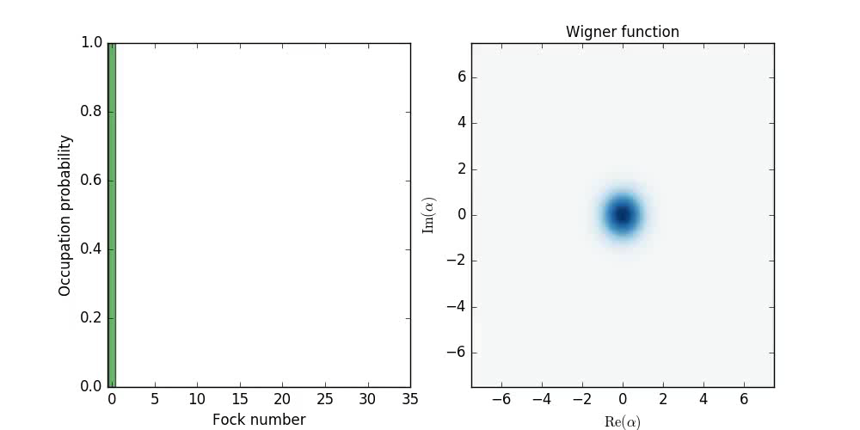

Degenerate Parametric Amplifier
Output below threshold: squeezed vacuum
Note: squeezed vacuum has finite number of photons in it
^{[1]}
$$\hat{H}=\frac{1}{2}iℏ\left(ε{\left({\hat{a}}^{†}\right)}^{2}+ε^{∗}{\left(\hat{a}\right)}^{2}\right)$$
^{[1]} Python package QUTIP

Slide 8
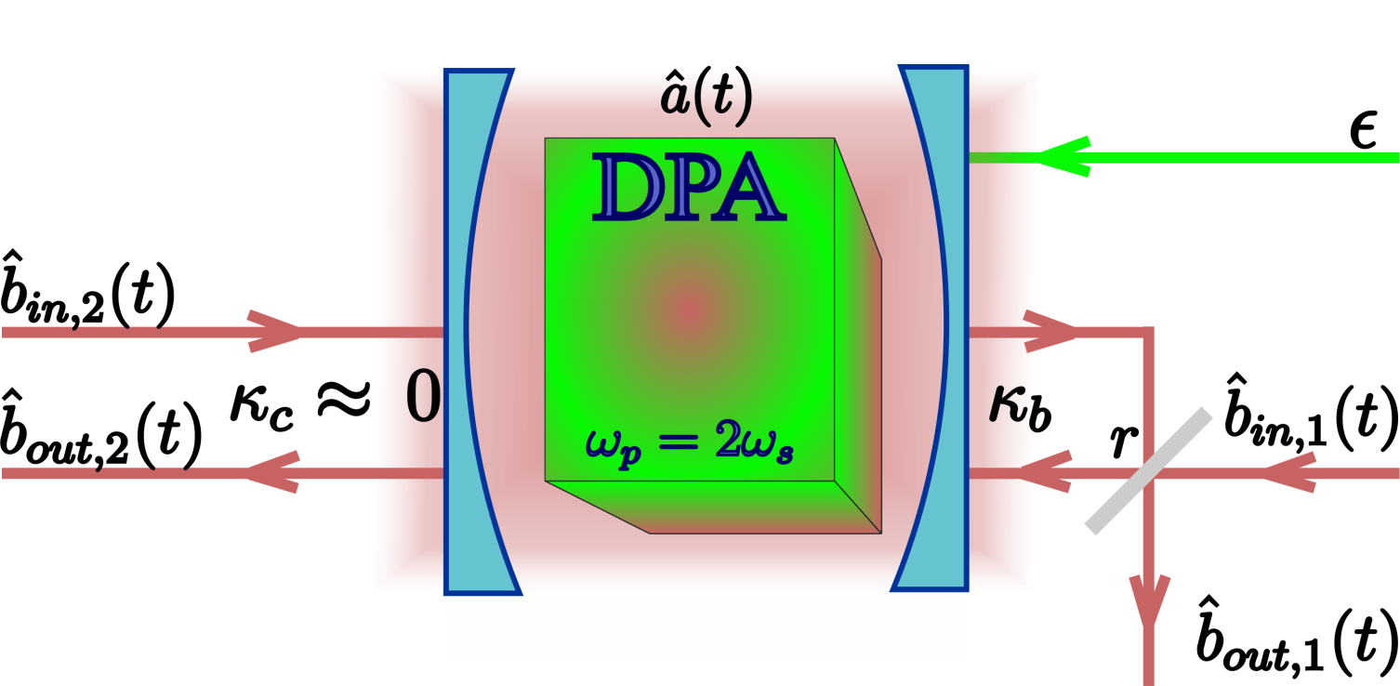
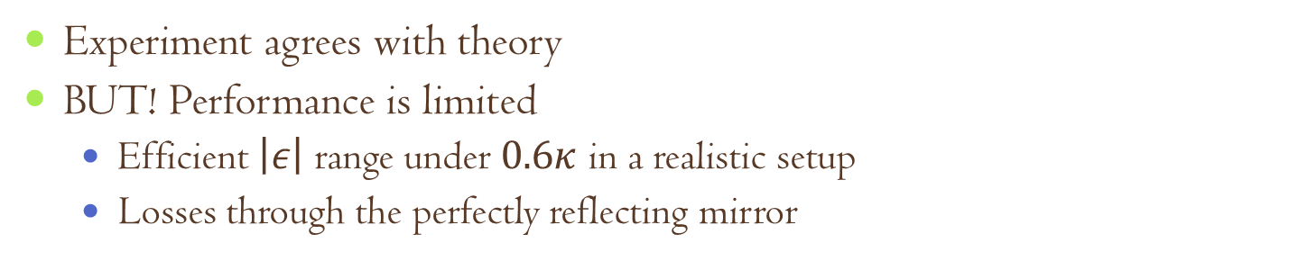
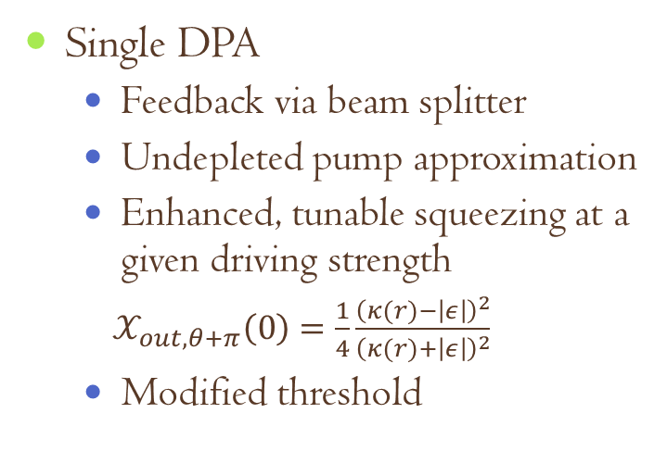
Coherent feedback with DPA^{[1,2]}
Coherent feedback: Quantum feedback without measurement
Single DPA
Feedback via beam splitter
Undepleted pump approximation
Enhanced, tunable squeezing at a given driving strength
$𝒳_{out,θ+π}\left(0\right)=\frac{1}{4}\frac{{\left(κ(r)−\left|ε\right|\right)}^{2}}{{\left(κ(r)+\left|ε\right|\right)}^{2}}$
Modified threshold
Experiment agrees with theory
BUT! Performance is limited
Efficient $\left|ε\right|$ range under $0.6κ$ in a realistic setup
Losses through the perfectly reflecting mirror
^{[1]} J. E. Gough, S. Wildfeuer, PRA, 80:042107 (2009), ^{[2]}A. Furusawa’s group, IEEE Trans. Auto. Contr., 57:2045 (2012)

Slide 9
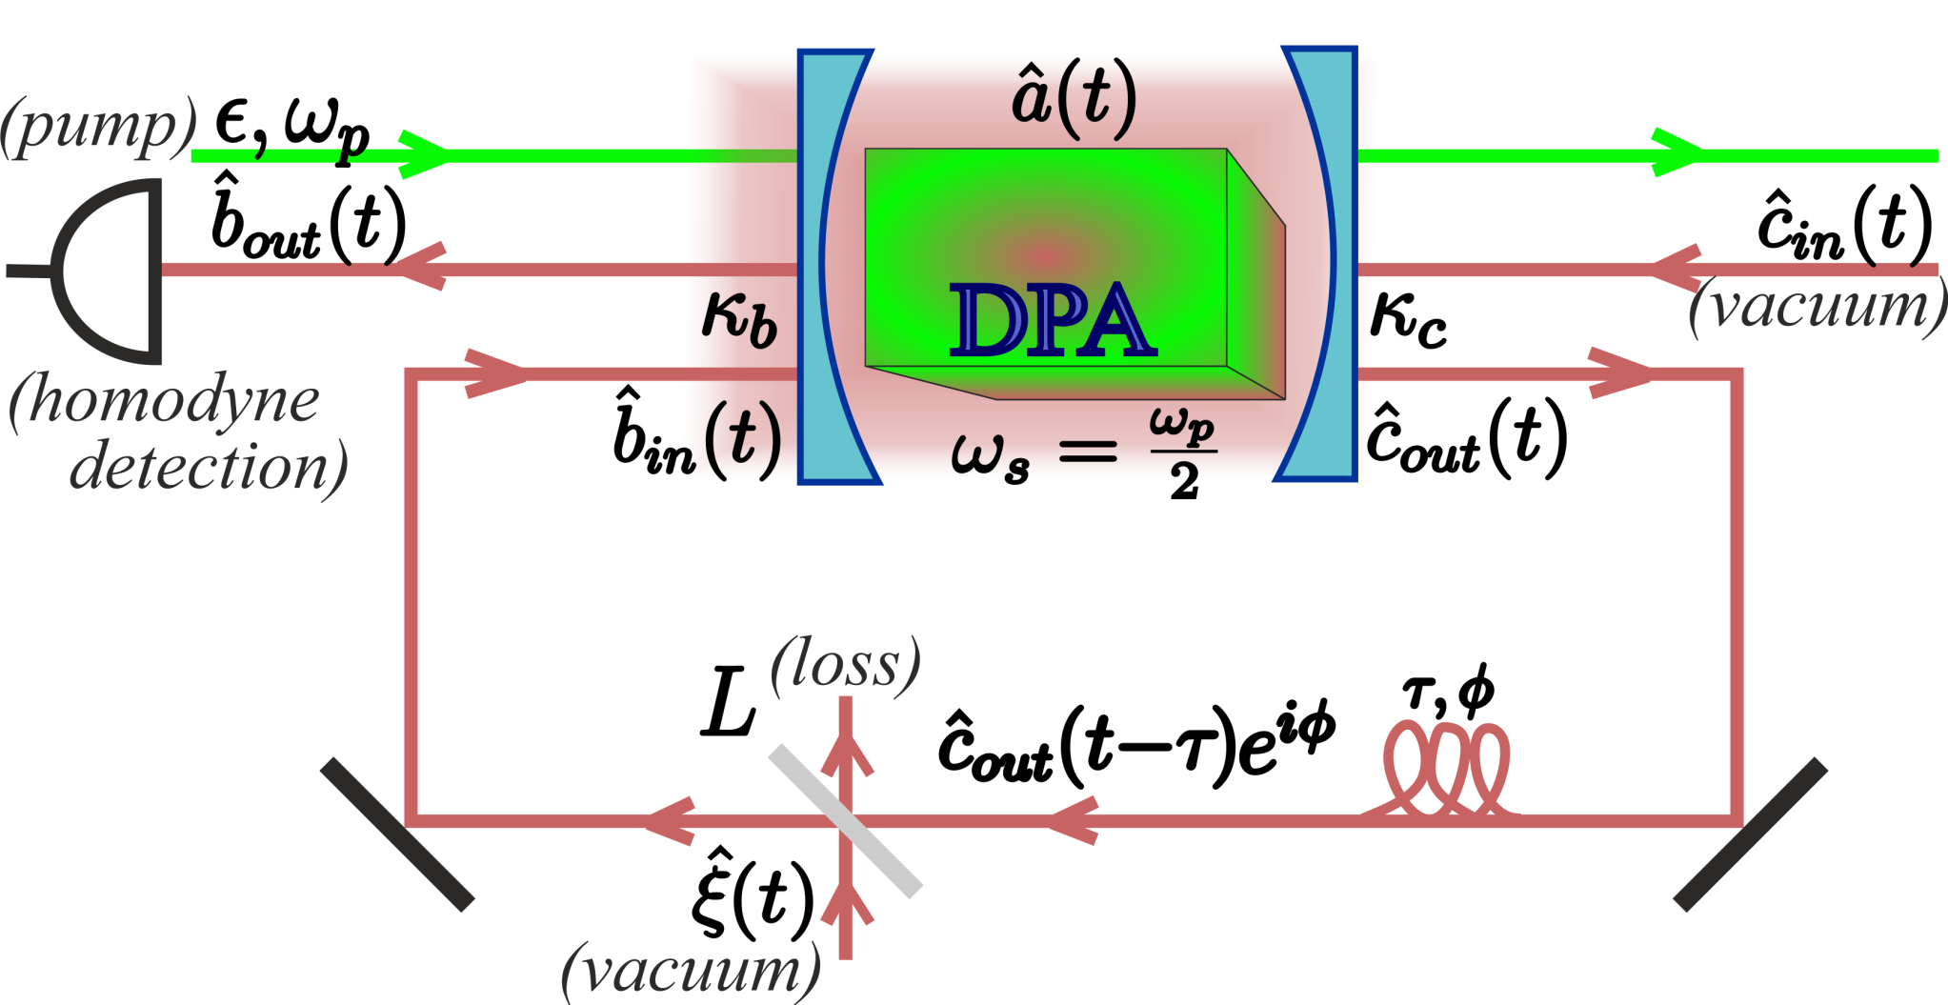
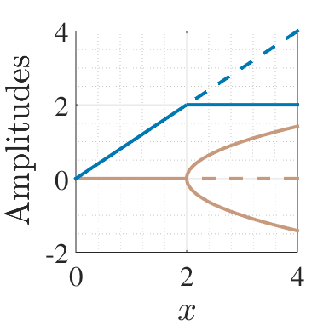
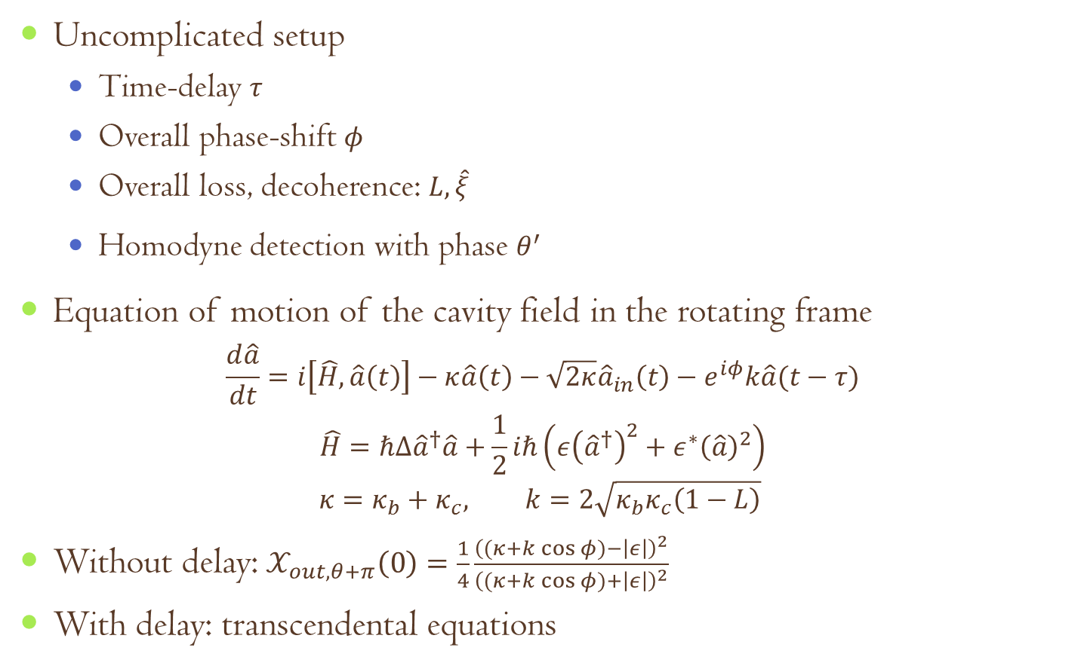
DPA with time-delayed coherent feedback
Uncomplicated setup
Time-delay $τ$
Overall phase-shift $φ$
Overall loss, decoherence: $L,\hat{ξ}$
Homodyne detection with phase $θ^{′}$
Equation of motion of the cavity field in the rotating frame
$$\frac{d\hat{a}}{dt}=i\left[\hat{H},\hat{a}\left(t\right)\right]−κ\hat{a}\left(t\right)−\sqrt{2κ}{\hat{a}}_{in}\left(t\right)−e^{iφ}k\hat{a}(t−τ)$$
$$\hat{H}=ℏΔ{\hat{a}}^{†}\hat{a}+\frac{1}{2}iℏ\left(ε{\left({\hat{a}}^{†}\right)}^{2}+ε^{∗}{\left(\hat{a}\right)}^{2}\right)$$
$$κ=κ_{b}+κ_{c}, k=2\sqrt{κ_{b}κ_{c}\left(1−L\right)}$$
Without delay: $𝒳_{out,θ+π}\left(0\right)=\frac{1}{4}\frac{{\left((κ+k\cos{φ})−\left|ε\right|\right)}^{2}}{{\left((κ+k\cos{φ})+\left|ε\right|\right)}^{2}}$
With delay: transcendental equations

Slide 10
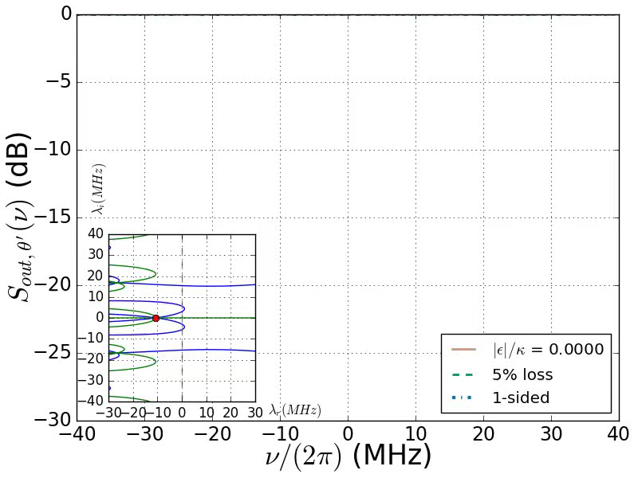

Squeezing spectra for $φ=π$

Slide 11
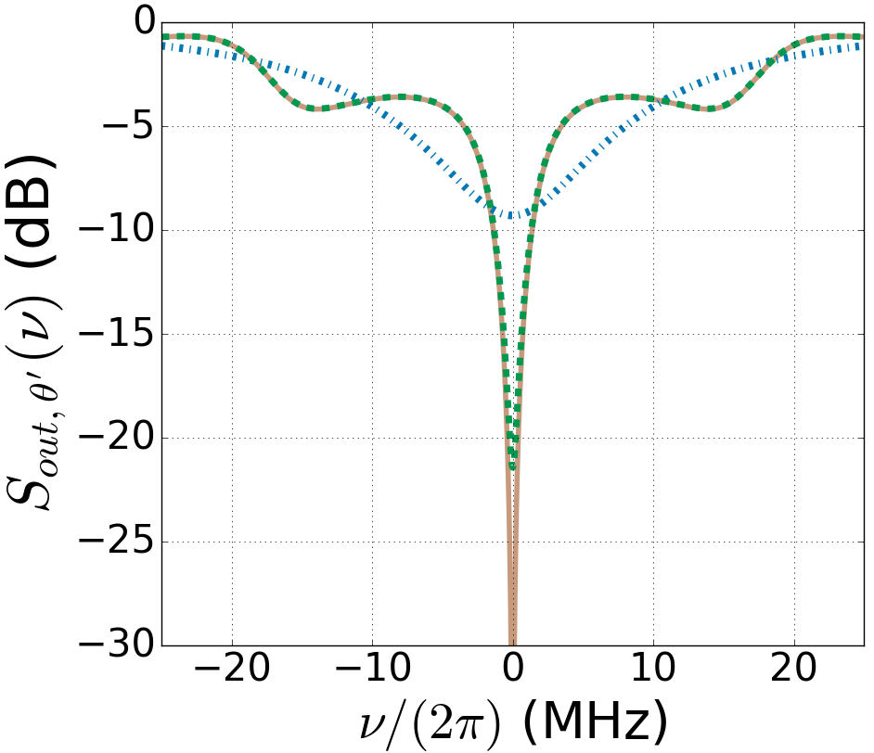
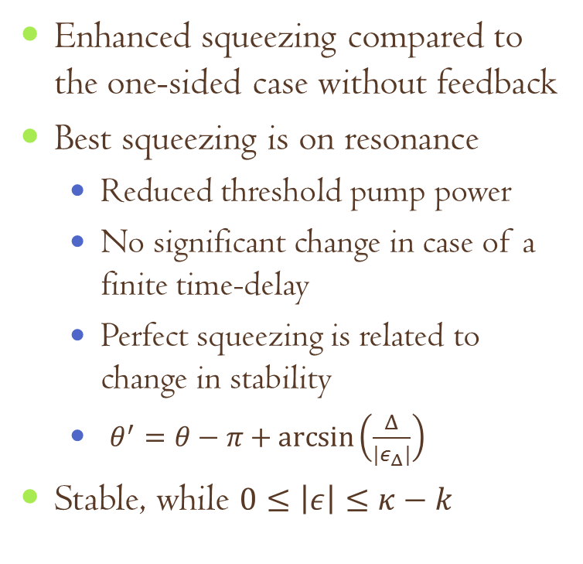
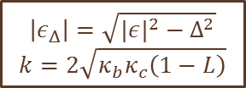

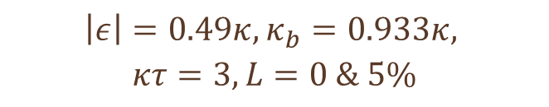
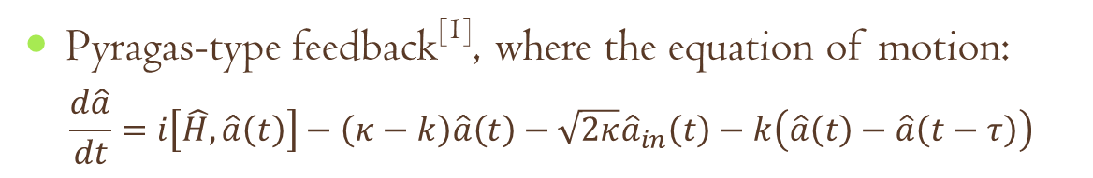
Squeezing for $φ=π$
Enhanced squeezing compared to the one-sided case without feedback
Best squeezing is on resonance
Reduced threshold pump power
No significant change in case of a finite time-delay
Perfect squeezing is related to change in stability
$θ^{′}=θ−π+\arcsin\left(\frac{Δ}{{|ε}_{Δ}|}\right)$
Stable, while $0≤\left|ε\right|≤κ−k$
$$\left|ε\right|=0.49κ, κ_{b}=0.933κ,$$
$$κτ=3,L=0 \& 5\%$$
Pyragas-type feedback^{[1]}, where the equation of motion:
$$\frac{d\hat{a}}{dt}=i\left[\hat{H},\hat{a}\left(t\right)\right]−\left(κ−k\right)\hat{a}\left(t\right)−\sqrt{2κ}{\hat{a}}_{in}\left(t\right)−k\left(\hat{a}\left(t\right)−\hat{a}\left(t−τ\right)\right)$$
$$\left|ε_{Δ}\right|=\sqrt{|{ε|}^{2}−Δ^{2}}$$
$$k=2\sqrt{κ_{b}κ_{c}\left(1−L\right)}$$
^{[1]} K. Pyragas, PLA, 170:421 (1992)

Slide 12
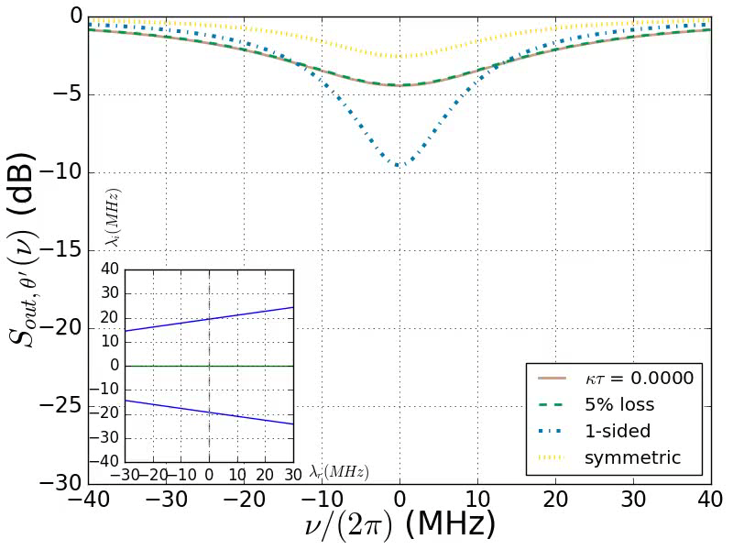

Squeezing spectra for $φ=0$

Slide 13
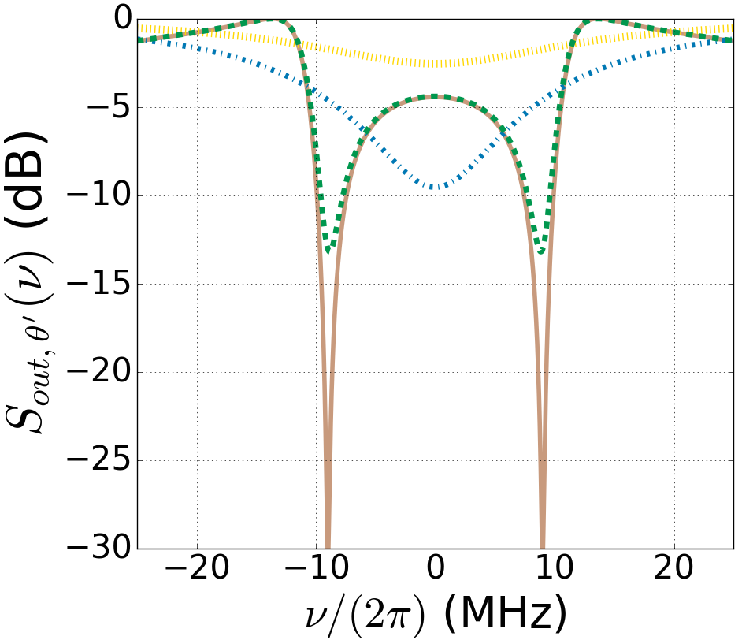
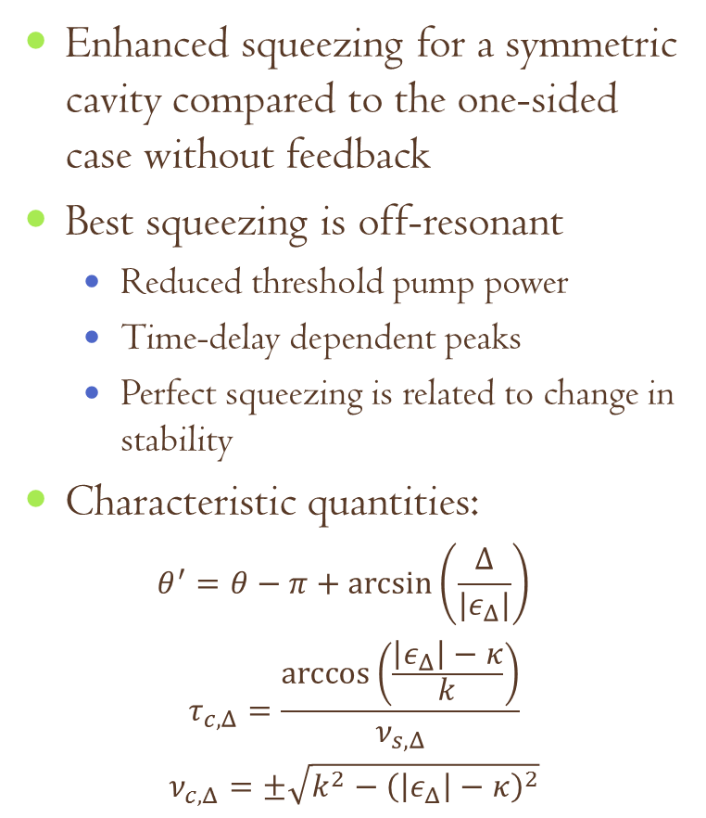

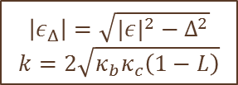
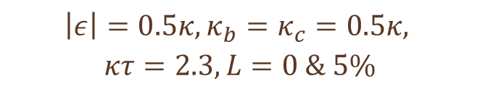
Squeezing for $φ=0$
Enhanced squeezing for a symmetric cavity compared to the one-sided case without feedback
Best squeezing is off-resonant
Reduced threshold pump power
Time-delay dependent peaks
Perfect squeezing is related to change in stability
Characteristic quantities:
$$θ^{′}=θ−π+\arcsin\left(\frac{Δ}{{|ε}_{Δ}|}\right)$$
$$τ_{c,Δ}=\frac{\arccos\left(\frac{\left|ε_{Δ}\right|−κ}{k}\right)}{ν_{s,Δ}}$$
$$ν_{c,Δ}=±\sqrt{k^{2}−{\left(\left|ε_{Δ}\right|−κ\right)}^{2}}$$
$$\left|ε\right|=0.5κ, κ_{b}=κ_{c}=0.5κ,$$
$$κτ=2.3,L=0 \& 5\%$$
$$\left|ε_{Δ}\right|=\sqrt{|{ε|}^{2}−Δ^{2}}$$
$$k=2\sqrt{κ_{b}κ_{c}\left(1−L\right)}$$

Slide 14
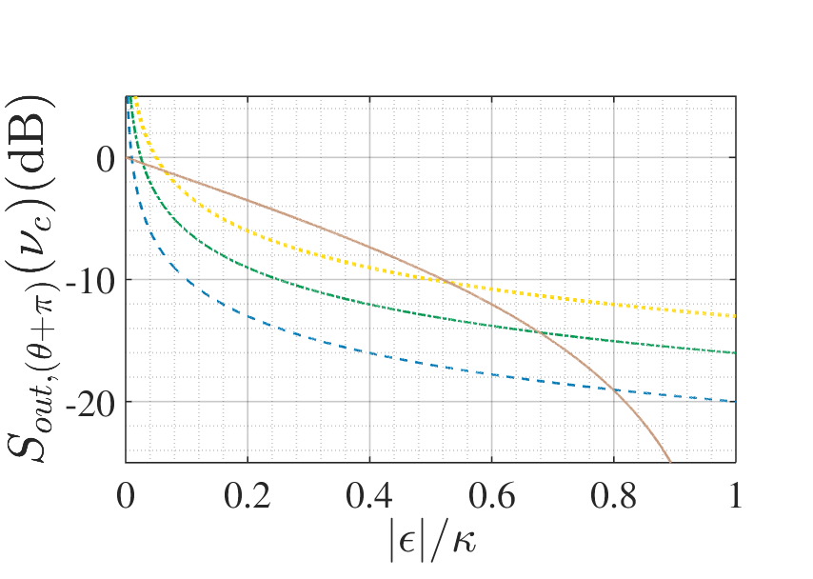
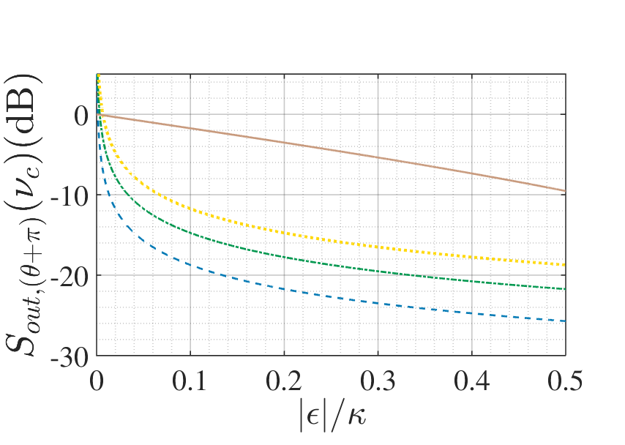
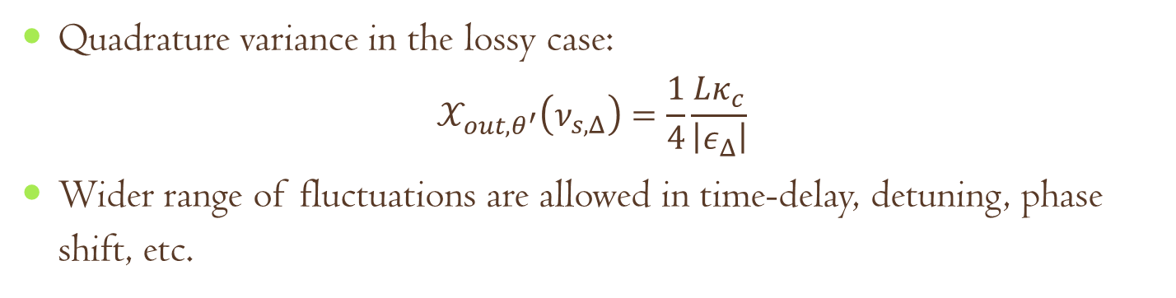
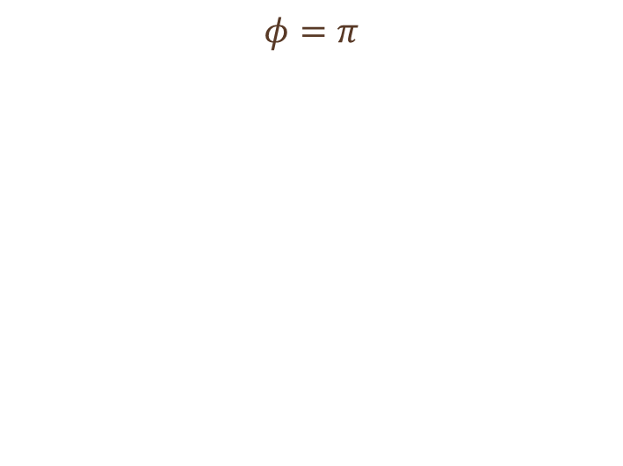
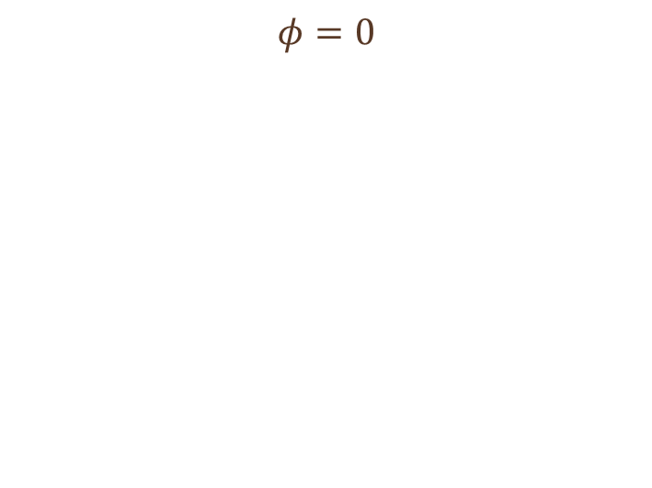
Effect of loss in the feedback loop
Quadrature variance in the lossy case:
$$𝒳_{out,θ^{′}}\left(ν_{s,Δ}\right)=\frac{1}{4}\frac{Lκ_{c}}{\left|ε_{Δ}\right|}$$
Wider range of fluctuations are allowed in time-delay, detuning, phase shift, etc.
$$φ=0$$
$$φ=π$$

Slide 15
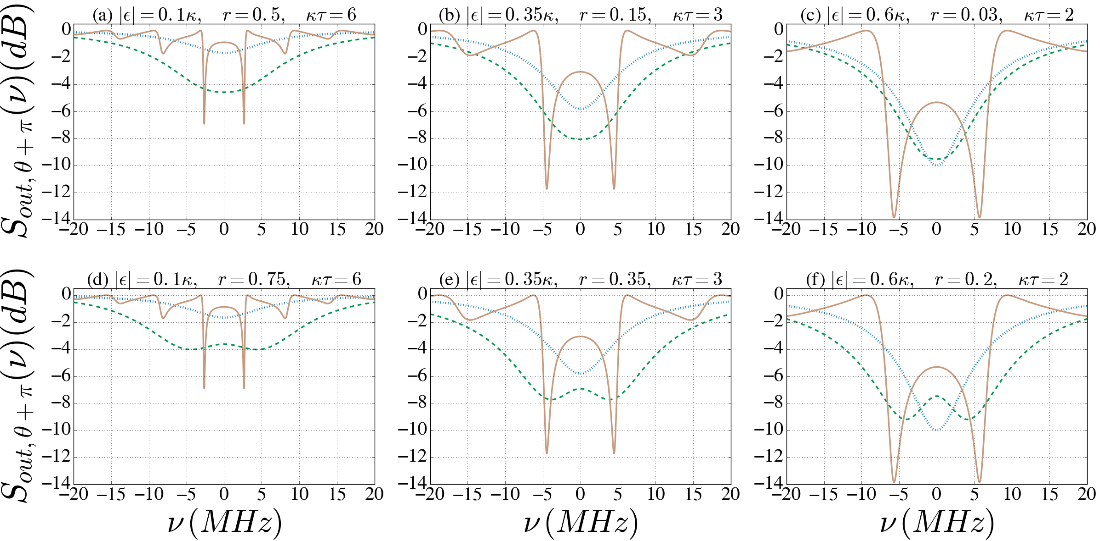
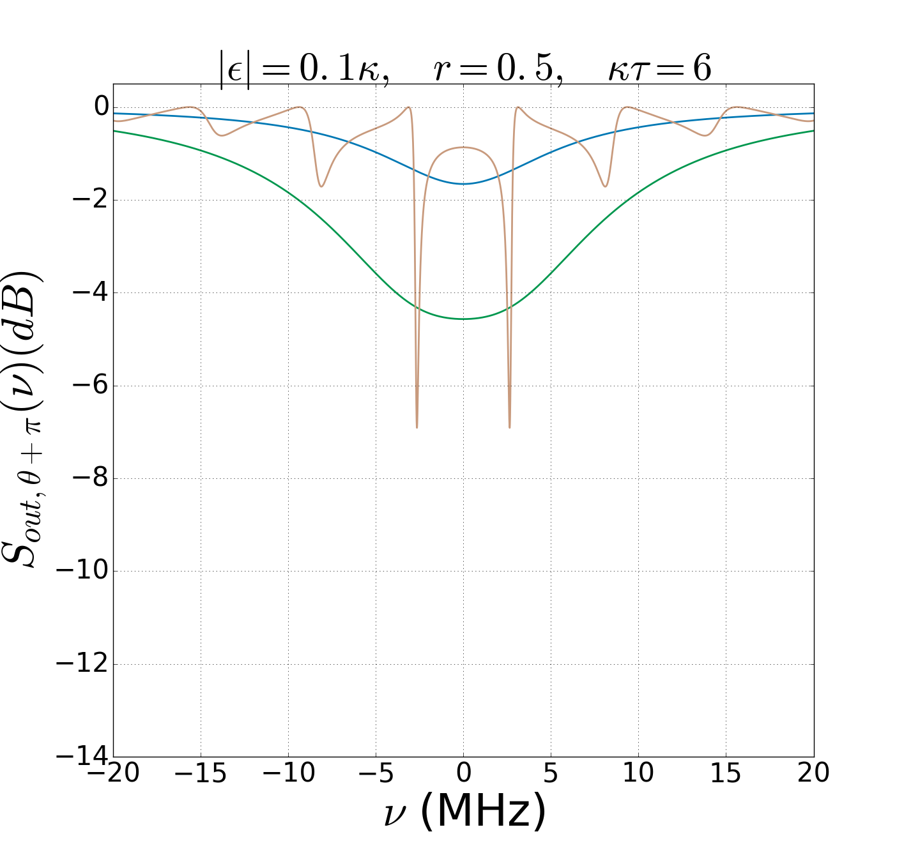
Comparison with previous results^{[1,2]}
with BS
feedback
without
feedback
with delayed feedback
without
feedback
with BS
feedback
without
feedback
with BS
feedback
with delayed feedback
with delayed feedback
^{[1]} J. E. Gough, S. Wildfeuer, PRA, 80:042107 (2009), ^{[2]}A. Furusawa’s group, IEEE Trans. Auto. Contr., 57:2045 (2012)

Slide 16
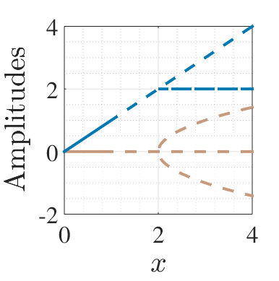
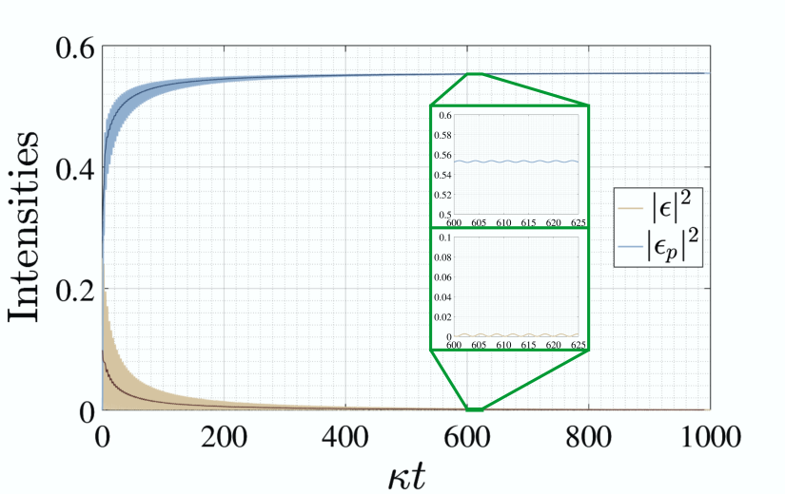
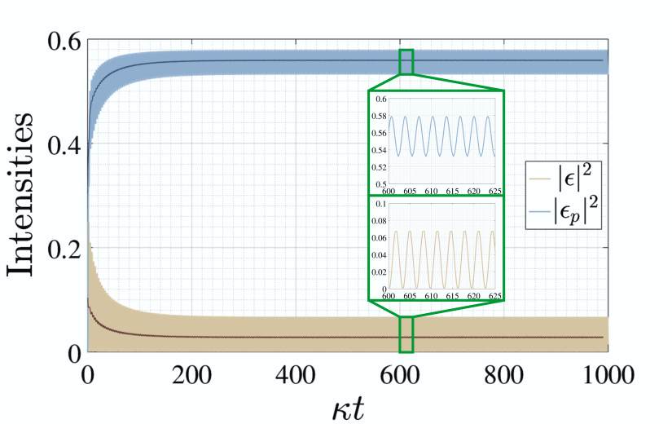
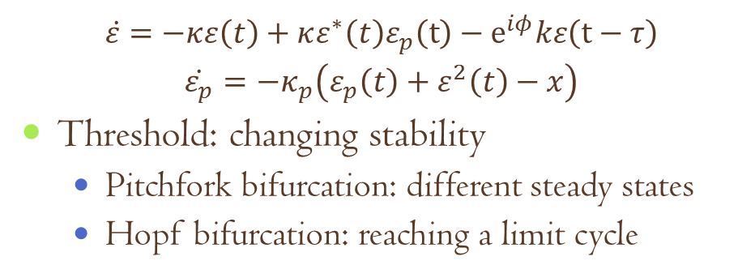
Classical analysis^{[1]}
$$\dot{ε}=−κε\left(t\right)+κε^{∗}\left(t\right)ε_{p}\left(t\right)−e^{iφ}kε\left(t−τ\right)$$
$$\dot{ε_{p}}=−κ_{p}\left(ε_{p}\left(t\right)+ε^{2}\left(t\right)−x\right)$$
Threshold: changing stability
Pitchfork bifurcation: different steady states
Hopf bifurcation: reaching a limit cycle
Imaginary eigenvalue becomes the frequency of persistent oscillations
^{[1]}Matlab package DDE-BIFTOOL, and solver dde23

Slide 17
Summary
More precise measurements with the help of squeezed states of light
Coherent feedback: backaction-free way of increasing the signal to noise ratio in quantum systems
Influence of time-delay: changes in the stability landscape
In a time-delayed one-loop setup with a DPA, dramatically enhanced squeezing was found
Enhancement even compared to previous feedback setups
Result of the changing dynamics of the system
Loss in the feedback loop decreases the degree of squeezing, but also provides higher tunability
Future plans:
Semiclassical treatment of DPA above threshold
Entanglement spectra in the Nondegenerate DPA

Slide 18
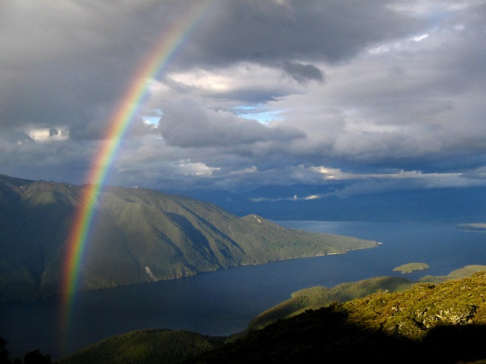



Thank you for your
1
2
3
4
5
6
7
8
9
10
11
12
13
14
attention!

Slide 19
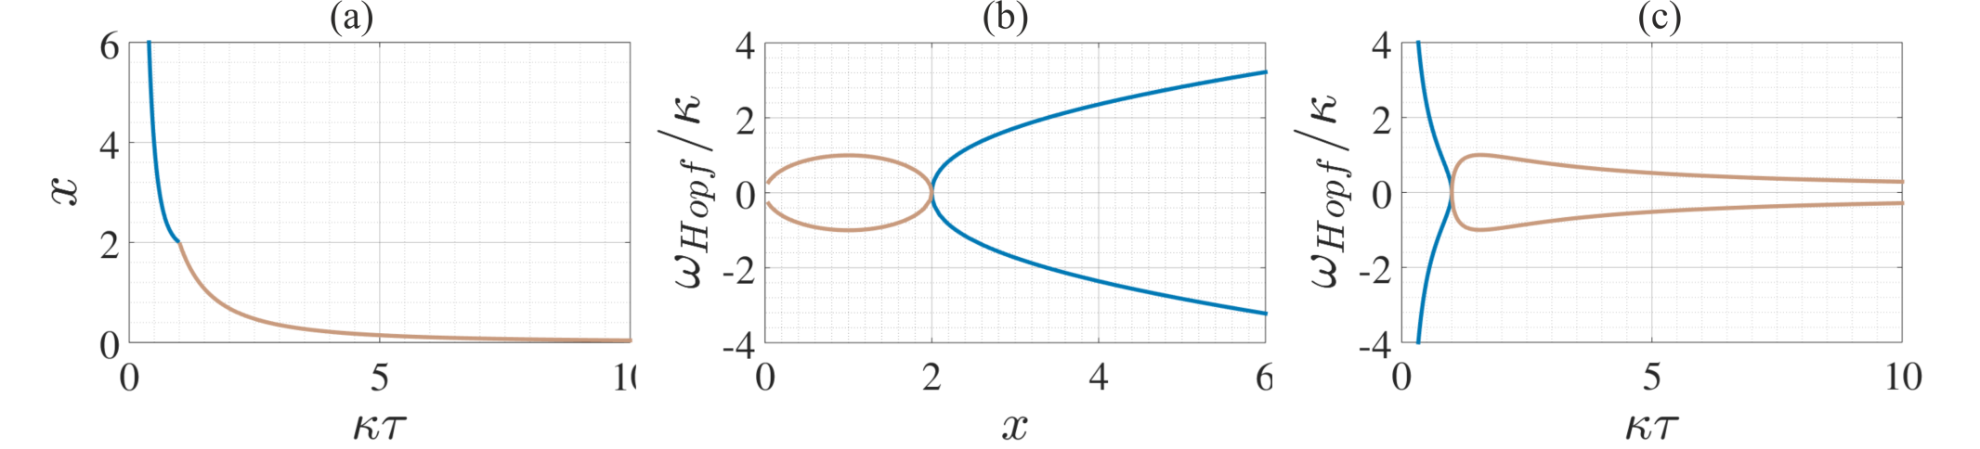
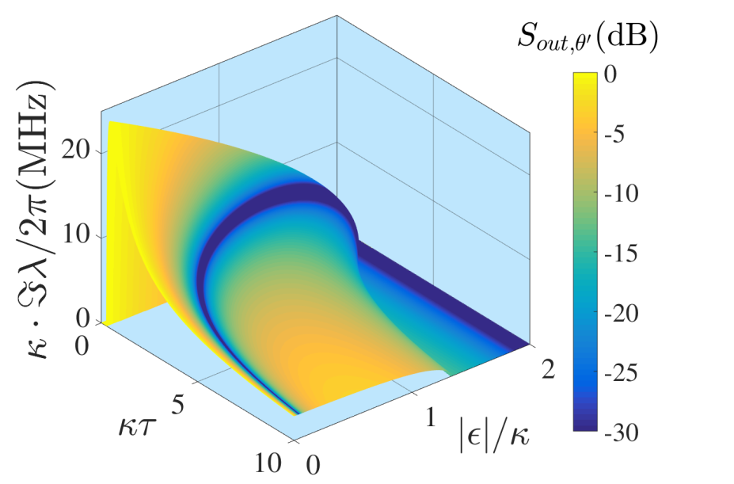
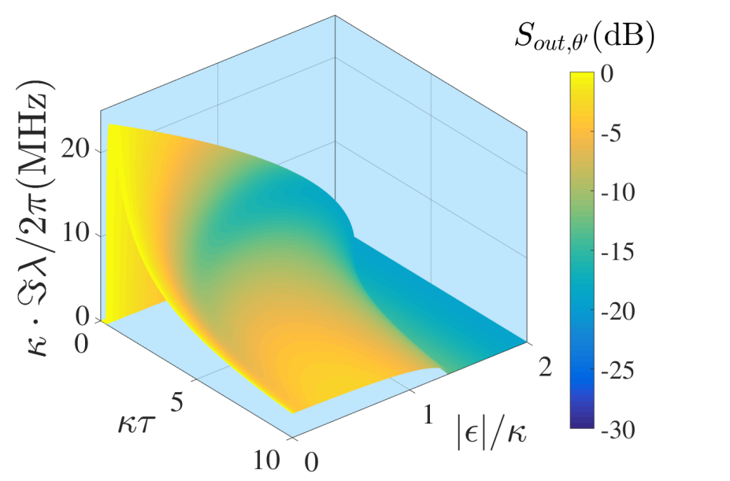
Tunability
$$0≤ν_{s}≤\sqrt{\left|ε\right|\left(2κ−\left|ε\right|\right)},0≤\left|ε\right|≤\left|κ+ke^{iφ}\right|$$

Slide 20
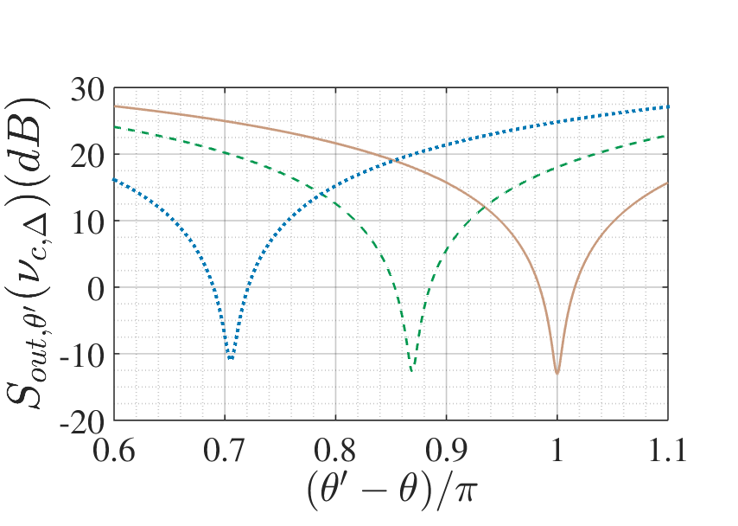
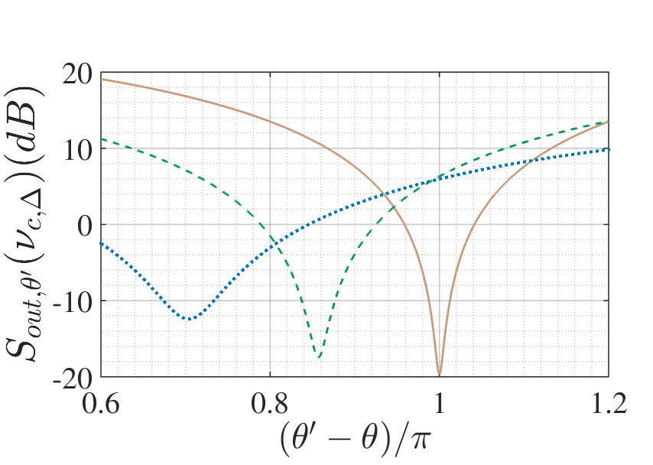
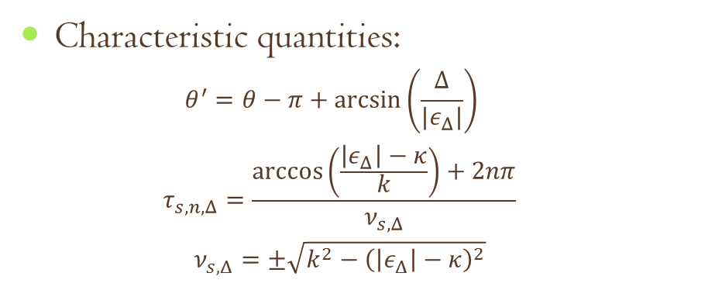



Effects of detuning
Characteristic quantities:
$$θ^{′}=θ−π+\arcsin\left(\frac{Δ}{{|ε}_{Δ}|}\right)$$
$$τ_{s,n,Δ}=\frac{\arccos\left(\frac{\left|ε_{Δ}\right|−κ}{k}\right)+2nπ}{ν_{s,Δ}}$$
$$ν_{s,Δ}=±\sqrt{k^{2}−{\left(\left|ε_{Δ}\right|−κ\right)}^{2}}$$
In the figures below:
$\left|ε\right|=const.$
$Δ=0$ (solid)
$Δ=0.1κ$ (dashed)
$Δ=0.2κ$ (dotted)
Optimal frequency and time-delay
$$φ=0$$
$$φ=π$$

Slide 21







Effects of a phase shift
In this figure:
$$k=κ, φ=\frac{π}{2}$$
$ε_{p}:$ real (blue), imag (green)
$ε:$ real (brown), imag (yellow)
In the figures below:
$\left|ε\right|=const.$
$φ=φ_{0}−0.1π$ (dotted)
$φ=φ_{0}−0.05π$ (dashed)
$φ=φ_{0}$ (solid)
Optimal frequency and time-delay
$$φ_{0}=0$$
$$φ_{0}=π$$

Slide 22



Frequency-dependent squeezing
Adding $π$ to the local oscillator phase in our case gives the following frequency-dependence of the optimal quadrature angle for the maximum squeezing:
Characteristic that is required for the new generation of gravitational wave detectors
Low frequencies: around $θ^{′}−θ=0$
High frequencies: around $θ^{′}−θ=π$

